Slide 1
Analyzing the Neighborhoods of Toronto for Starting a New Restaurant.
IBM Data Science Capstone Project
Tope Orire
05/20/2021

Slide 2

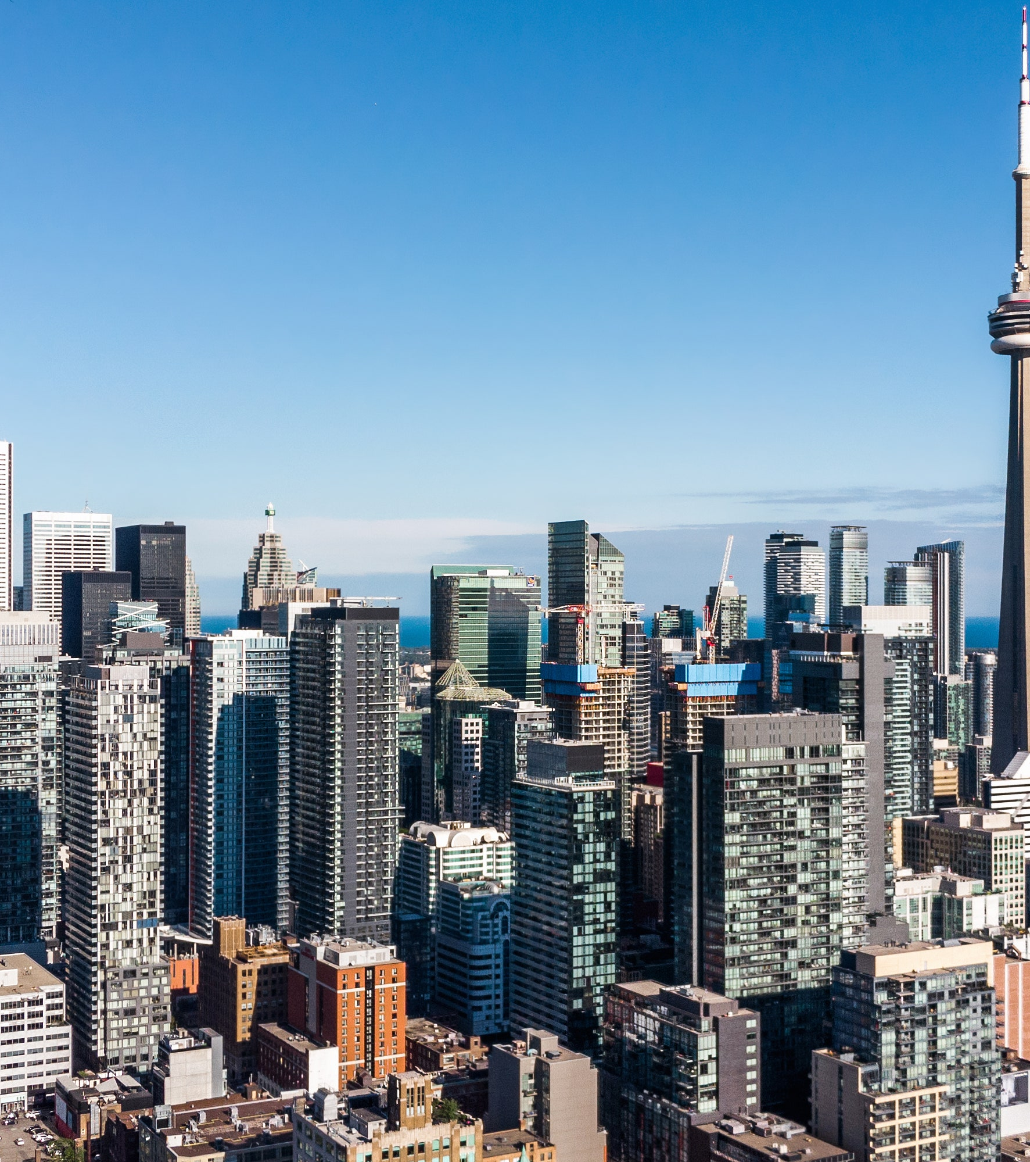


Introduction
Toronto is said to be a fast-growing city, that is unsurprising really with the number of new skyscrapers constantly popping up.
This is an incredible city for anyone to visit in Canada with tons of markets, delicious food, wonderful museums, and funky bars.
Toronto is also the most multicultural city in the world, offering tons of diversity and culture (including lots of delicious Asian food).
This report is a case study that analyzes the top neighborhoods in Toronto that would then be the best location to build a new restaurant for potential investors.

Slide 3
Business Problem
Potential Investors are interested in starting a new restaurant in Toronto. I have offered to help study the neighborhood and suggest a location that is best fit for this purpose. My main goal for this project is to properly analyze the right data about the several neighborhoods of Toronto using the data science skills I possess and then suggest to the potential investors, the best location to start a new restaurant

Slide 4
Data Collection
The neighborhood data used throughout this project analysis was scrapped from https://en.wikipedia.org/wiki/List_of_postal_codes_of_Canada:_M .
The geographical coordinates of Toronto were extracted using Geospatial Data in Python. These coordinates are important for plotting the map of Toronto and later, the map of other neighborhoods in the city.
The venue data has been extracted by querying the Foursquare API. Getting this data is necessary becomes it helps to see recommendations for all neighborhoods in the city.

Slide 5
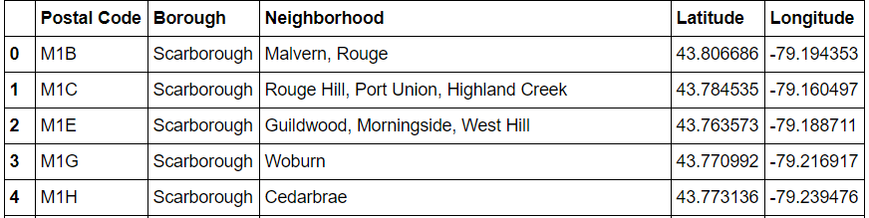
Data showing the latitude and longitudes coordinates of some neighborhoods after Data Collection and Clean up.

Slide 6
Methodology
Some of the important tools used were matplotlib function, json package, Folium package, BeautifulSoup, requests and k-means.
Features were extracted from the Foursquare API. These features are needed to build the unsupervised learning model to be used in this project.
The unsupervised learning approach used to cluster the neighborhoods is the K-means technique. The K-Means Method is a clustering algorithm that search clusters within the data, it then minimizes the data dispersion for each cluster.
The Folium library was used to plot the maps of neighborhoods in Toronto (Figure 6) as well as the that of the neighborhoods in consideration for this project(Figure 7).

Slide 7
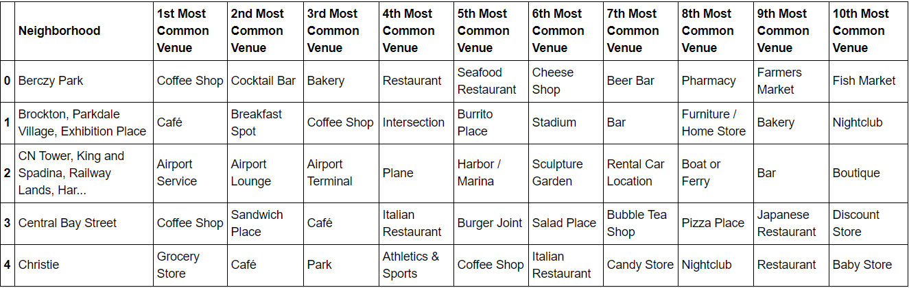


Showing the most common venues in each neighborhood

Slide 8
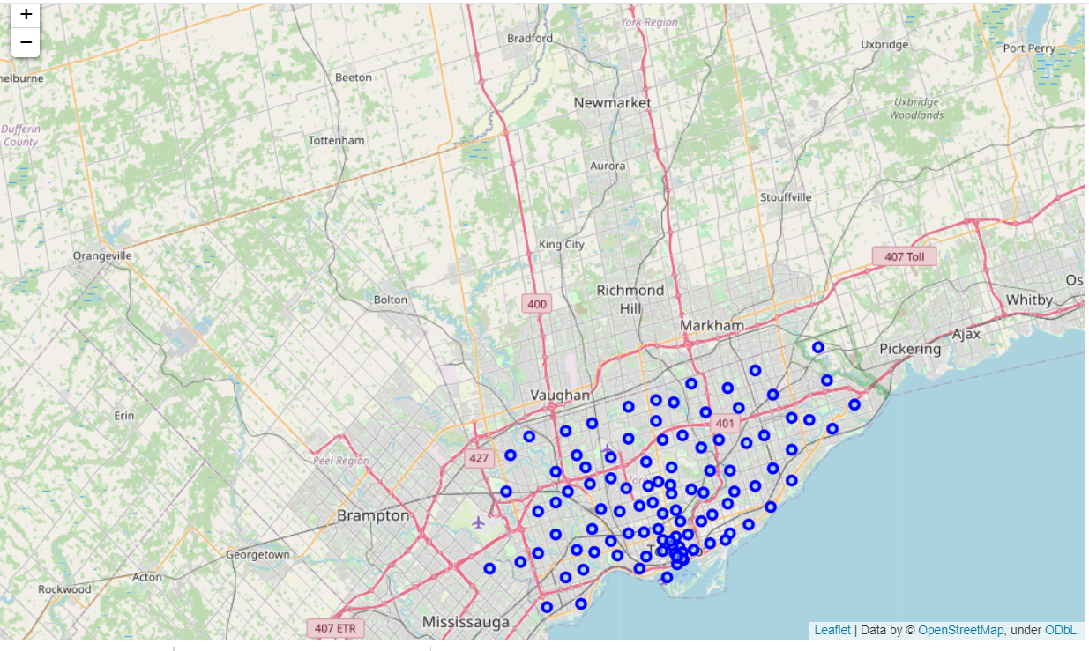
Map showing the neighborhoods in Toronto

Slide 9
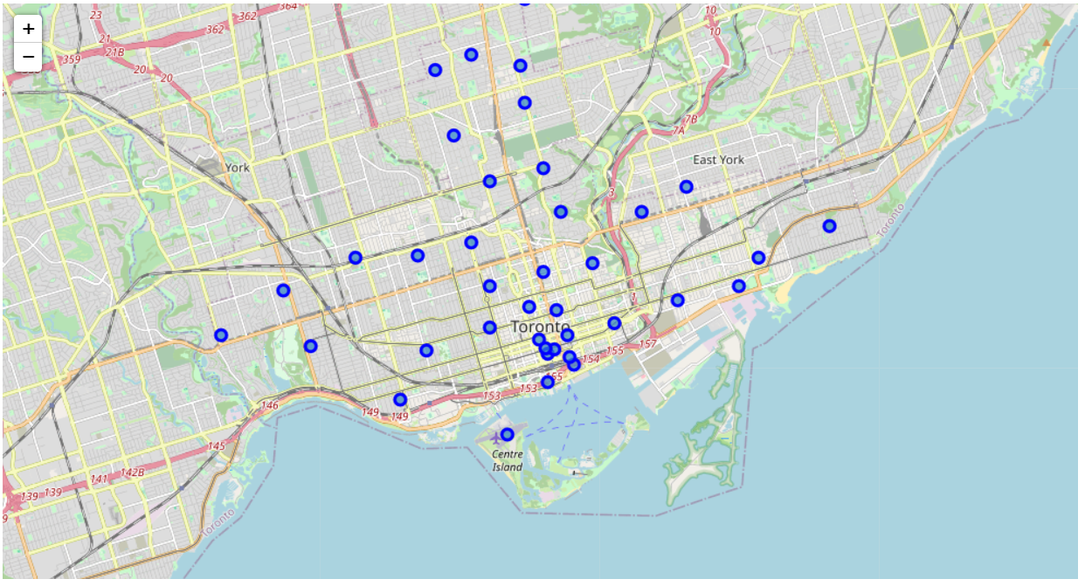
Map showing the neighborhoods in consideration for this project

Slide 10
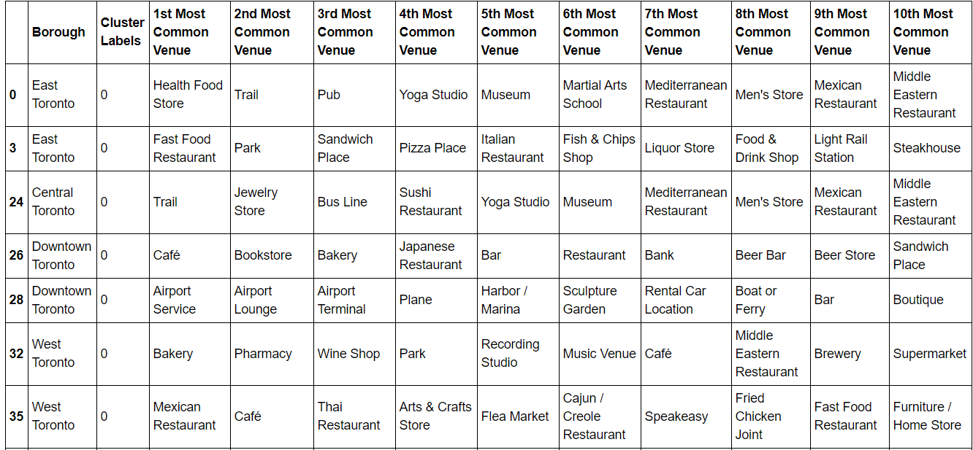
Results showing cluster label 0

Slide 11
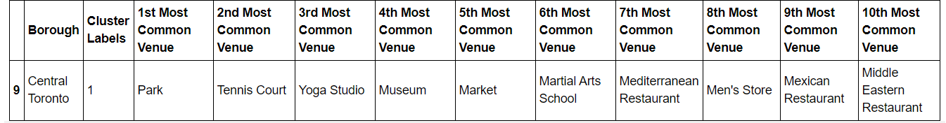
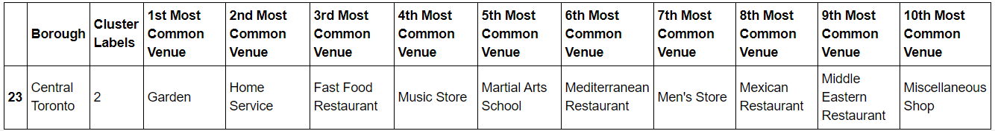
Results showing cluster 1 and 2
Cluster 1
Cluster 2

Slide 12
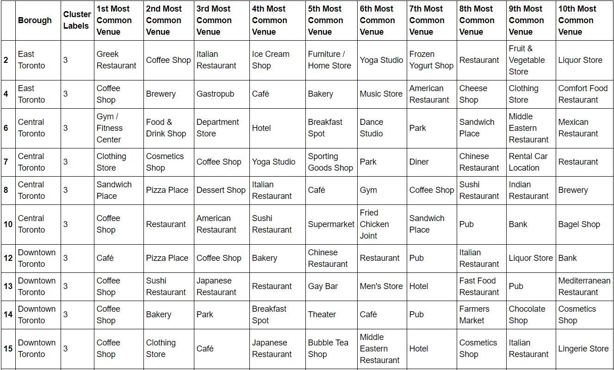
Results showing Cluster 3

Slide 13
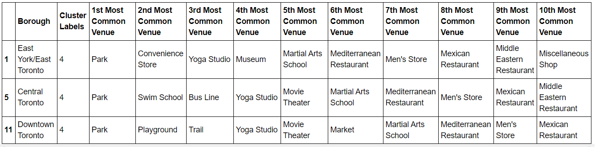
Results showing Cluster 4

Slide 14
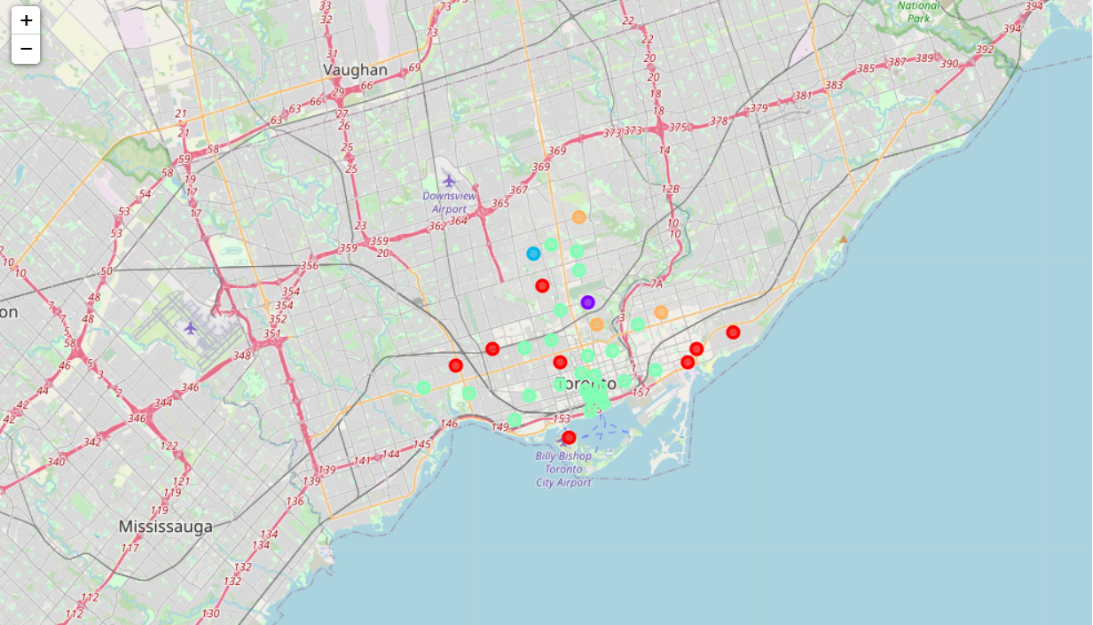
Map visualization after clustering

Slide 15
Discussion
We can see from the results shown above that Cluster 3 will provide the best neighborhoods to choose from when starting a new restaurant business.
I will, therefore, recommend to the potential investors that neighborhoods in East, Central and Downtown Toronto will be best fit to starting their business. it is also to be noted that there would be a high rate of competitions in these neighborhoods considering the number of restaurants already present in them.
If the potential investors wish to work is a less competitive neighborhood, I will then suggest cluster 0, that shows us that there are a lot of people around this region visiting parks and recreational centers.

Slide 16
Conclusion
This has been a great project for me to embark on. The data analysis and machine learning techniques used in this project were very helpful in determining solutions to the problem at hand.
This report has been able to analyze and adequately recommend the best neighborhoods to start a new restaurant.
The potential investors can then move forward with considering other factors like transportation, legal requirements and cost associated in starting a new restaurant. Those were not part of the scope of this project and therefore not considered.

